Slide 1


Slide 2
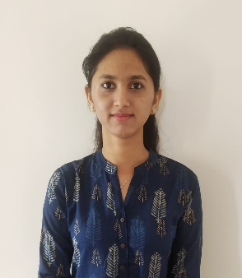
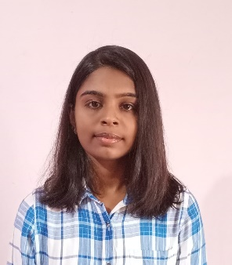
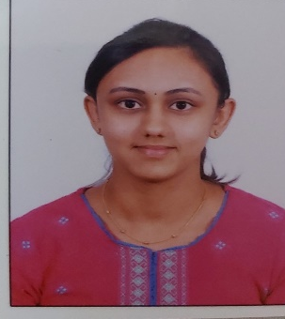
Project Highlights
Project Name :
Team Size :
BU Mentor Name : Mentor PS#
Team Members Details (Professional Stamp Size Photo with few lines of individual briefing
Ganavi Raj KG
99002534
2009MYSSPS01
BE in Information Science and Engineering
C,C++,HTML,DBMS
Harini J
99002541
2009MYSSPS01
BE in Information Science and Engineering
C,C++,Java
Sahana Rao PS
99002542
2009MYSSPS01
BE in Information Science and Engineering
C,C++ ,HTML, DBMS

Slide 3
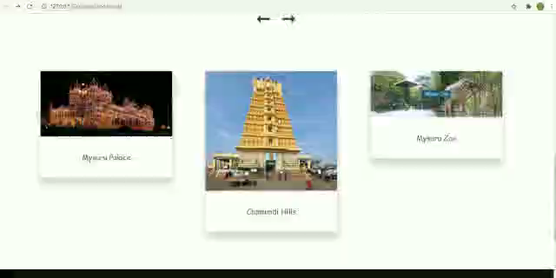
Project Video Snippet

Slide 4
Future development that can be implemented further
Session Storage
The system can be further enhanced by adding more places .
The system can be connected to database.

Slide 5

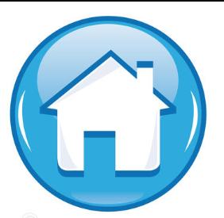
Thank You !

